Slide 1
E6156 – Topics in SW Engineering: Cloud Computing
Lecture 2: Microservices, REST, PaaS, S3
© Donald F. Ferguson, 2021

Slide 2

Static Web Hosting
2 | E6156 – Topics in SW Engineering: Cloud Computing: Lecture 2 – REST, PaaS, S3 © Donald F. Ferguson, 2021

Slide 3
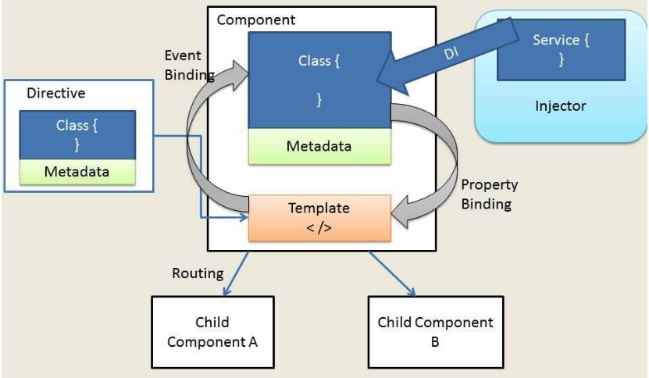
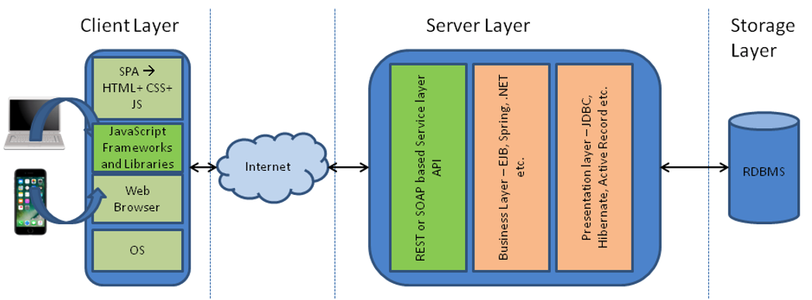
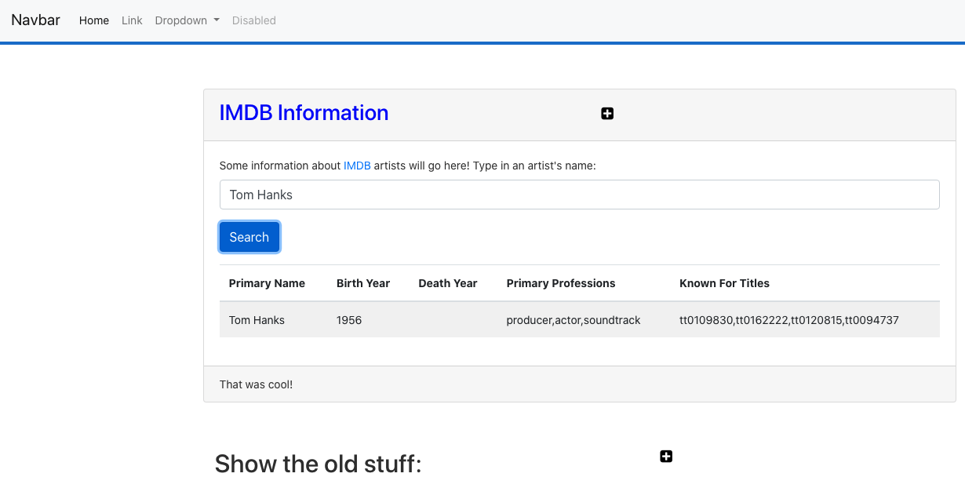
Web Application Architecture
https://dzone.com/articles/architectural-shift-in-web-applications-with-emerg
app.component
navbar.component
imdbartist.component
Template (HTML)
CSS
Component implementation
Service
Show the Code

Slide 4
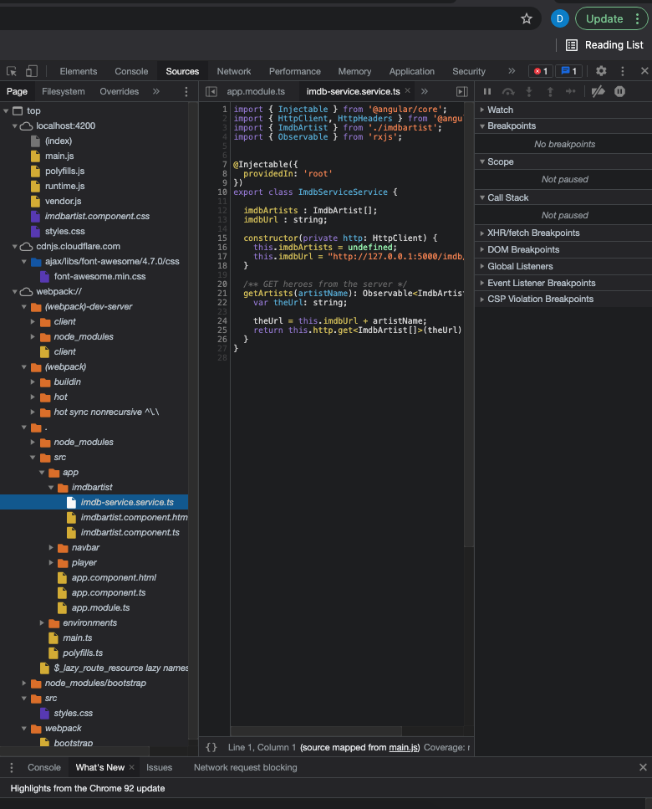
What’s in the Browser
The browser is an application that interprets the files:
HTML, CSS, etc. define the document and content.
JavaScript defines dynamic behavior.
Browser loads index.html
index.html contains links to files.
The browser loads the linked files.
These also have links, which the browser loads.
etc.
How did all of this get in the browser?
A web server delivers these files from “the file system.”
During development, Angular uses a simple, embedded web server.
Deploying the application to the cloud →
We have seen deploying the application logic to the cloud.
What about the content?
Notes:
Show loading the demo-ui.
Show loading cnn.com.

Slide 5
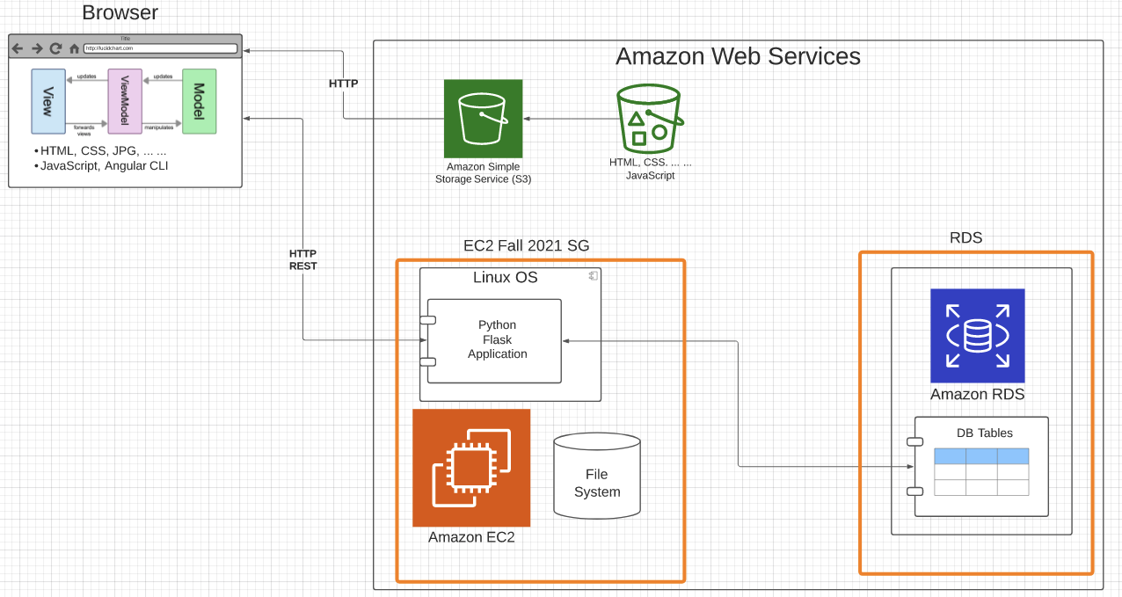
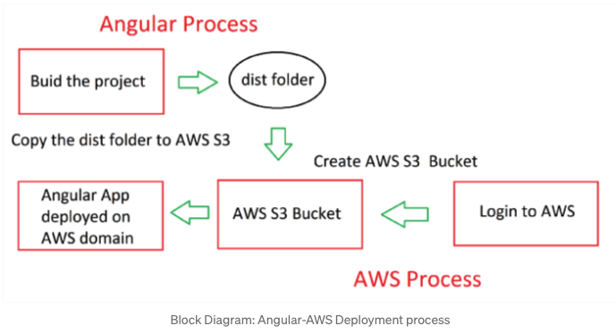
Deploy to S3
https://baljindersingh013.medium.com/angular-app-deployment-with-aws-s3-42d9008734ab
Compile the browser application (ng build -- prod)
You can test with ng serve -- prod
Generates “bundles” that contain:
JavaScript application logic.
HTML, content, ... In the app logic.
Create an S3 bucket.
Upload files from /dist folder.
Enable static web hosting.
Set access permissions.
Set index.html.
We will learn how to automate later.

Slide 6
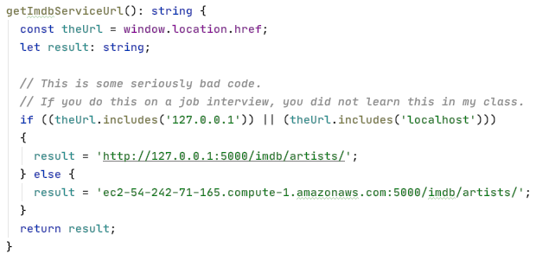
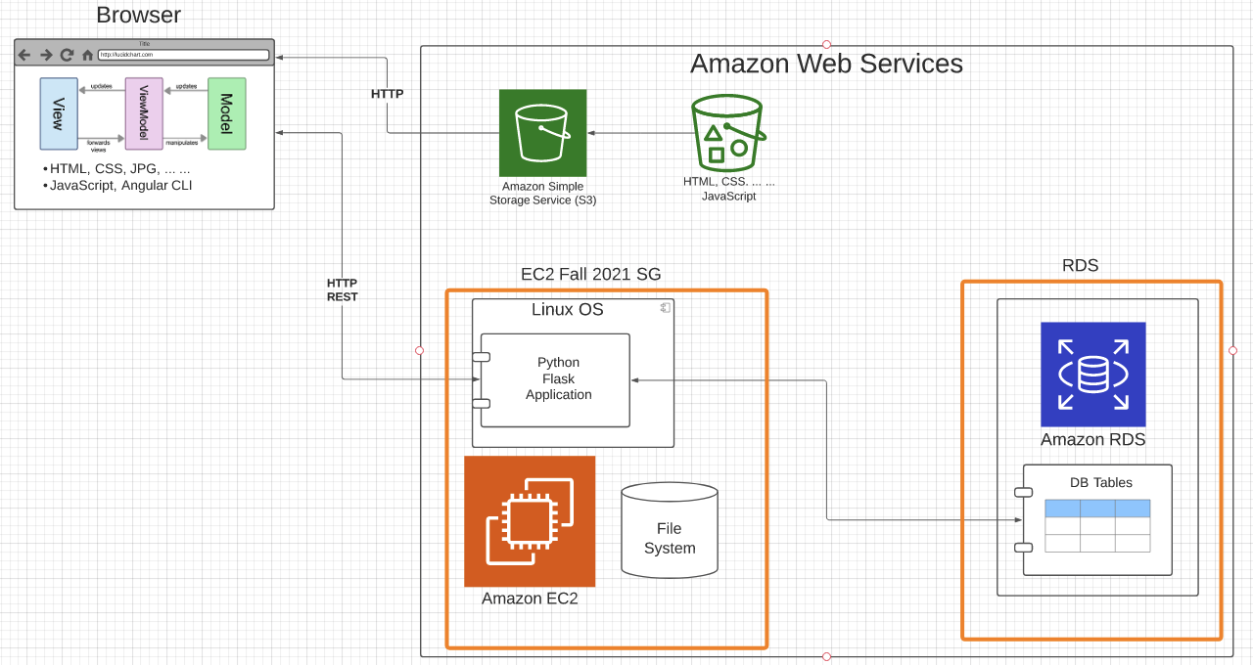
Some Comments
The code is not quite correct: The browser code needs to
Access the local application during dev/test.
The EC2 deployed app during production.
I hacked the code. There are better approaches.
I could have deployed the code on EC2 and delivered from application (Show demo).
This would be suboptimal.
Web serving and web application serving have different design points for scaling, availability, ... ...
I could have deployed MySQL on the EC2 instance, but web app serving and DB serving have different design points.
Why two security groups.
Only the web application can connect to the DB.
This makes it harder to break into my database and steal information.

Slide 7
Introduction to REST
7 | E6156 – Topics in SW Engineering: Cloud Computing: Lecture 2 – REST, PaaS, S3 © Donald F. Ferguson, 2021

Slide 8
REST (https://restfulapi.net/)
What is REST
REST is acronym for REpresentational State Transfer. It is architectural style for distributed hypermedia systems and was first presented by Roy Fielding in 2000 in his famous dissertation.
Like any other architectural style, REST also does have it’s own 6 guiding constraints which must be satisfied if an interface needs to be referred as RESTful. These principles are listed below.
Guiding Principles of REST
Client–server – By separating the user interface concerns from the data storage concerns, we improve the portability of the user interface across multiple platforms and improve scalability by simplifying the server components.
Stateless – Each request from client to server must contain all of the information necessary to understand the request, and cannot take advantage of any stored context on the server. Session state is therefore kept entirely on the client.
Cacheable – Cache constraints require that the data within a response to a request be implicitly or explicitly labeled as cacheable or non-cacheable. If a response is cacheable, then a client cache is given the right to reuse that response data for later, equivalent requests.
Uniform interface – By applying the software engineering principle of generality to the component interface, the overall system architecture is simplified and the visibility of interactions is improved. In order to obtain a uniform interface, multiple architectural constraints are needed to guide the behavior of components. REST is defined by four interface constraints: identification of resources; manipulation of resources through representations; self-descriptive messages; and, hypermedia as the engine of application state.
Layered system – The layered system style allows an architecture to be composed of hierarchical layers by constraining component behavior such that each component cannot “see” beyond the immediate layer with which they are interacting.
Code on demand (optional) – REST allows client functionality to be extended by downloading and executing code in the form of applets or scripts. This simplifies clients by reducing the number of features required to be pre-implemented.

Slide 9
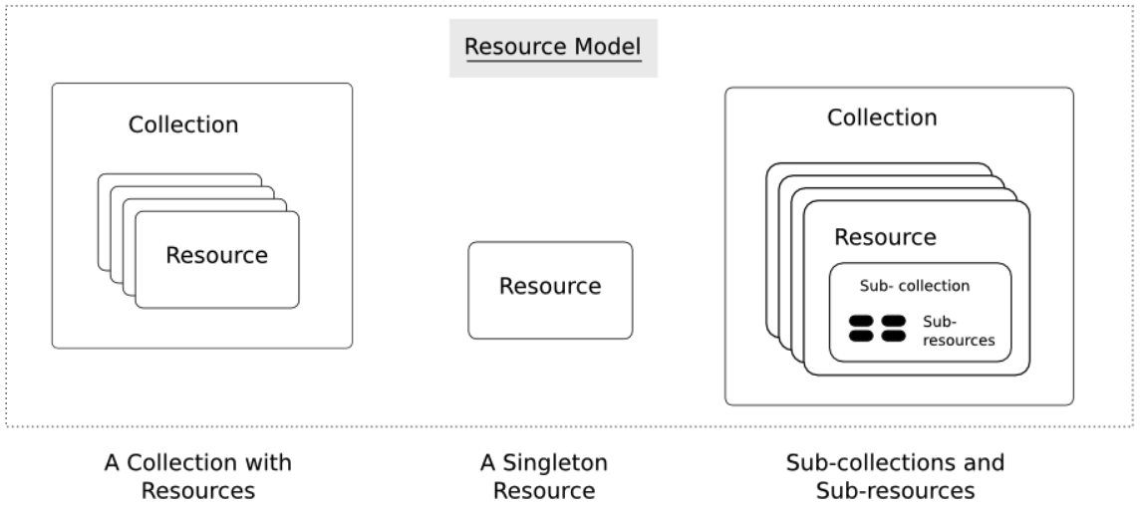
Resources
Resources are an abstraction. The application maps to create things and actions.
“A resource-oriented API is generally modeled as a resource hierarchy, where each node is either a simple resource or a collection resource. For convenience, they are often called a resource and a collection, respectively.
A collection contains a list of resources of the same type. For example, a user has a collection of contacts.
A resource has some state and zero or more sub-resources. Each sub-resource can be either a simple resource or a collection resource.
For example, Gmail API has a collection of users, each user has a collection of messages, a collection of threads, a collection of labels, a profile resource, and several setting resources.
While there is some conceptual alignment between storage systems and REST APIs, a service with a resource-oriented API is not necessarily a database, and has enormous flexibility in how it interprets resources and methods. For example, creating a calendar event (resource) may create additional events for attendees, send email invitations to attendees, reserve conference rooms, and update video conference schedules. (Emphasis added) (https://cloud.google.com/apis/design/resources#resources)
https://restful-api-design.readthedocs.io/en/latest/resources.html

Slide 10
REST – Resource Oriented
When writing applications, we are used to writing functions or methods:
openAccount(last_name, first_name, tax_payer_id)
account.deposit(deposit_amount)
account.close()
We can create and implement whatever functions we need.
REST only allows four methods:
POST: Create a resource
GET: Retrieve a resource
PUT: Update a resource
DELETE: Delete a resource
That’s it. That’s all you get.
A REST client needs no prior knowledge about how to interact with any particular application or server beyond a generic understanding of hypermedia.
“The key characteristic of a resource-oriented API is that it emphasizes resources (data model) over the methods performed on the resources (functionality). A typical resource-oriented API exposes a large number of resources with a small number of methods.” (https://cloud.google.com/apis/design/resources)

Slide 11
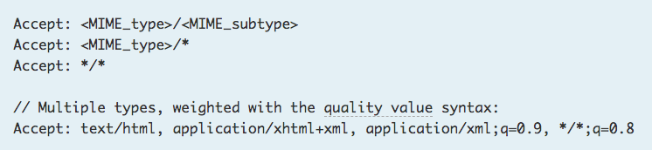
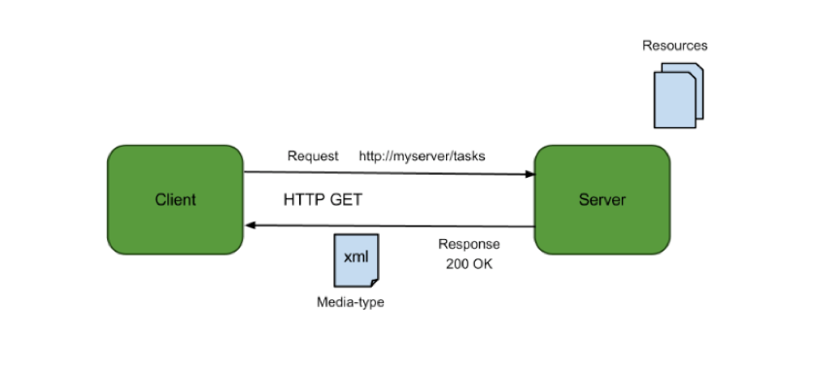
Resources, URLs, Content Types
Relative URL identifies “resource” on the server.
Server implementation maps abstract resource to tangible “thing,” file, DB row, … and any application logic.
Accept type in headers.
Client may be
Browser
Mobile device
Other REST Service
… …
Web media (content) type, e.g.
text/html
application/json

Slide 12
REST Principles
What about all of those principles?
Client/Server
Stateless
Cacheable
Uniform Interface
Layered System
Code on demand
Some of these principles are simple and obvious. Some of the principles are subtle and have major implications.
We will go into the principles in later lectures, ... but first
A little about microservices.
Introduction to Platform-as-a-Service.
Build out our first resource oriented, REST microservice (s)

Slide 13
Introduction to Microservices
13 | E6156 – Topics in SW Engineering: Cloud Computing: Lecture 2 – REST, PaaS, S3 © Donald F. Ferguson, 2021

Slide 14
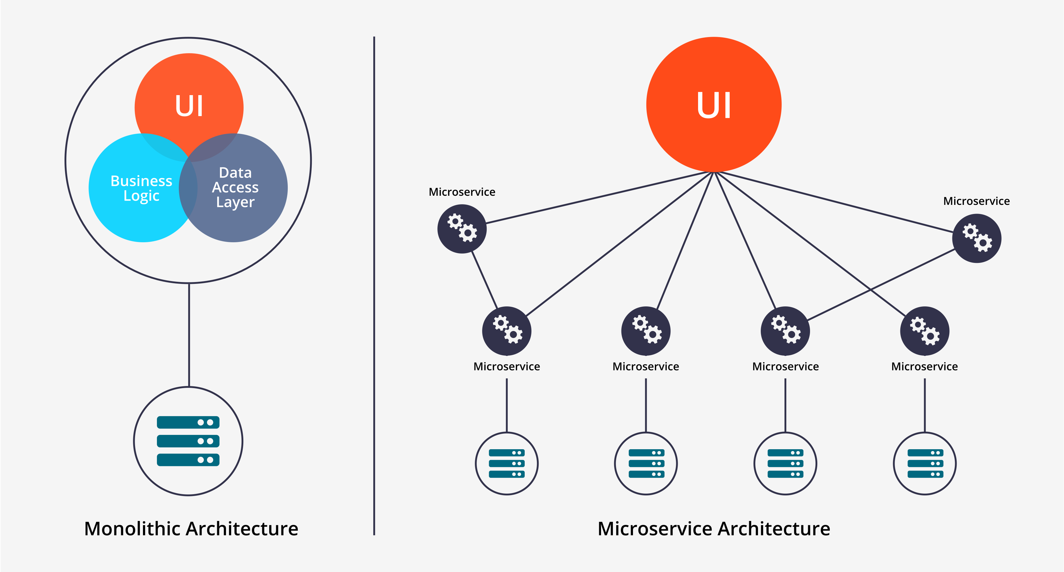
Microservices
Historically, complex applications were implemented and deployed as “one big application.”
Monolith Architecture is built in one large system and usually one code-base. A monolith is often deployed all at once, both front-end and back-end code together, regardless of what was changed.
Microservices Architecture is built as a suite of small services, each with their own code-base. These services are built around specific capabilities and are usually independently deployable.
Components of Microservices architecture:
The services are independent, small, and loosely coupled
Encapsulates a business or customer scenario
Every service is a different codebase
Services can be independently deployed
Services interact with each other using APIs
https://medium.com/hengky-sanjaya-blog/monolith-vs-microservices-b3953650dfd

Slide 15
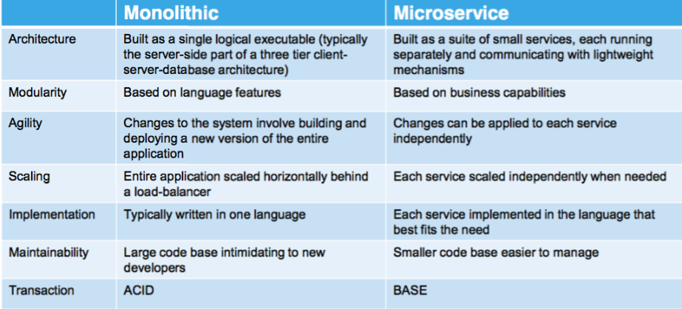
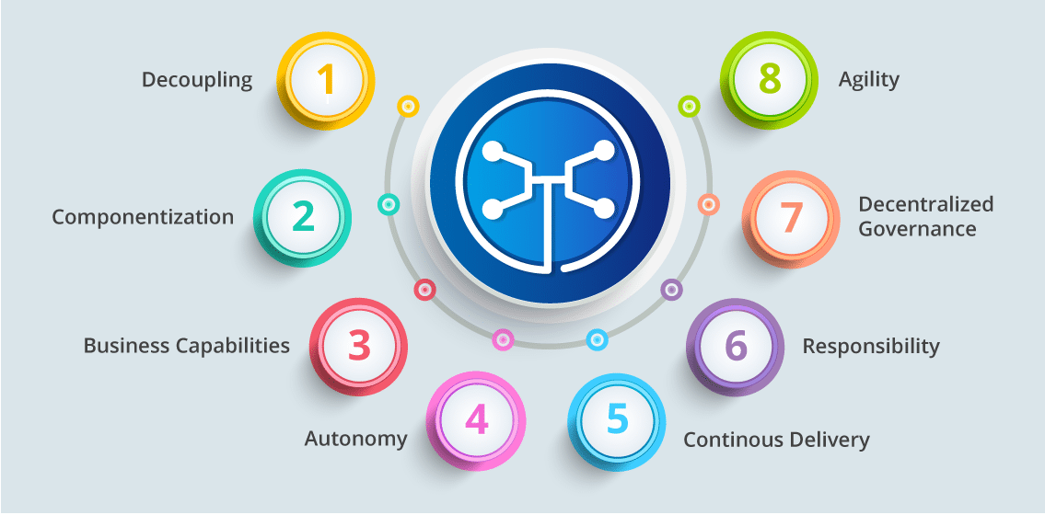
Microservices
You can drive yourself crazy trying to:
Compare microservice architectures to other architecture patterns.
Define the characteristics of microservices. What makes something a microservice?
Why do I cover microservices?
It does have benefits in large scale SW development projects.
It looks “cool” on your resume.

Slide 16
Introduction to PaaS Elastic Beanstalk
16 | E6156 – Topics in SW Engineering: Cloud Computing: Lecture 2 – REST, PaaS, S3 © Donald F. Ferguson, 2021

Slide 17
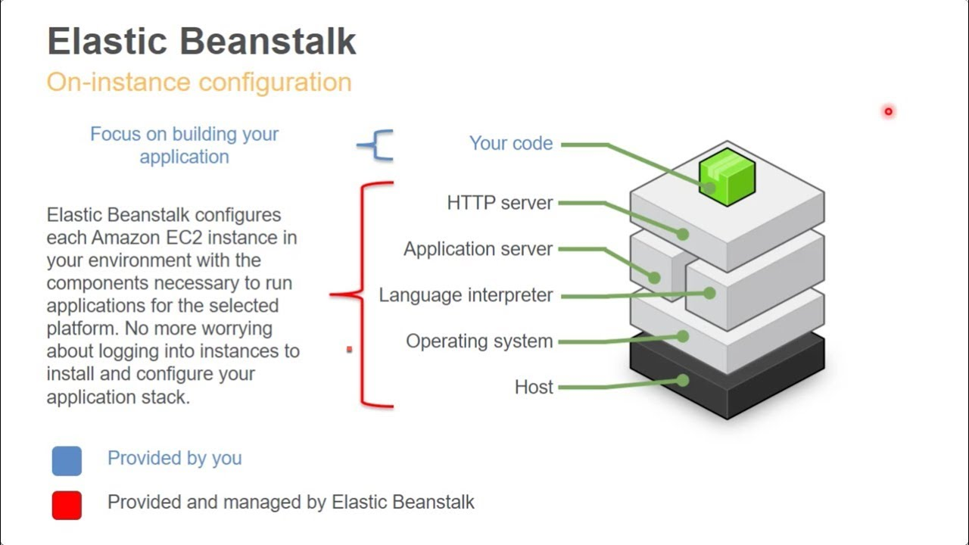
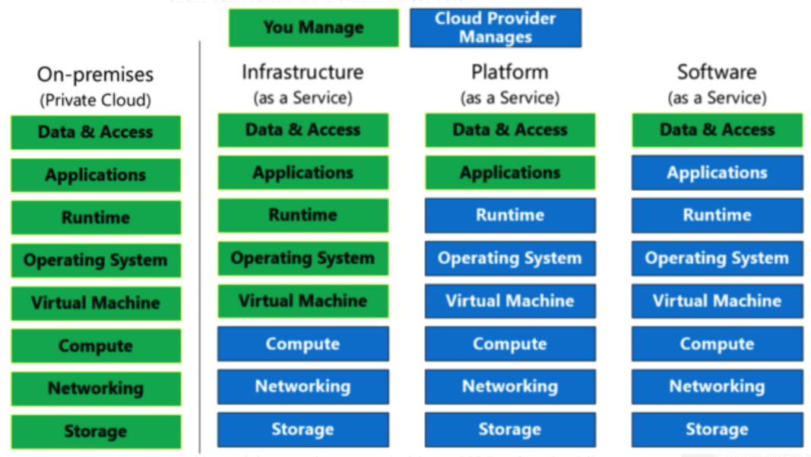
Platform-as-a-Service
Simplistically, PaaS adds two additional layers on top of IaaS:
Runtime means the language environment, libraries, etc. your application needs. For example, in our case this will mean a predefined and configured Flask environment.
“Middleware is a type of computer software that provides services to software applications beyond those available from the operating system.” (https://en.wikipedia.org/wiki/Middleware)
Basically, you do not have to build an application execution environment by installing libraries, services, ... You application “goes into a premade environment.”
Less flexible and customizable than IaaS but can be more productive to use for application scenarios.

Slide 18
Start with Elastic Beanstalk
There are several reasonably good tutorials on using EB and Flask
https://docs.aws.amazon.com/elasticbeanstalk/latest/dg/create-deploy-python-flask.html
https://medium.com/analytics-vidhya/deploying-a-flask-app-to-aws-elastic-beanstalk-f320033fda3c
AWS and technology evolve. So, sometimes you have to tinker with them.
The first time you deploy, it can be error prone. But after you succeed, modifying or deploying new applications is “rinse and repeat.”
I normally just:
Create an environment with the sample application.
Download the sample and un-compress.
Modify the application to add functions.
Upload a new version.
There are a couple of issues:
Make start with a new environment and add just the packages you need.
If you add packages, you must use pip freeze > requirements.txt.
Zip acts weird, especially on Mac.
Do not zip the folder. Go inside the folder and zip just the contents you need.
On Mac: zip -r -X Archive.zip *
Note: Walk through EB console and development process.
Show sample from my GitHub repo.

Slide 19
API First Design
19 | E6156 – Topics in SW Engineering: Cloud Computing: Lecture 2 – REST, PaaS, S3 © Donald F. Ferguson, 2021

Slide 20
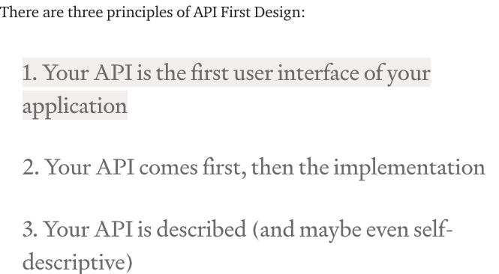
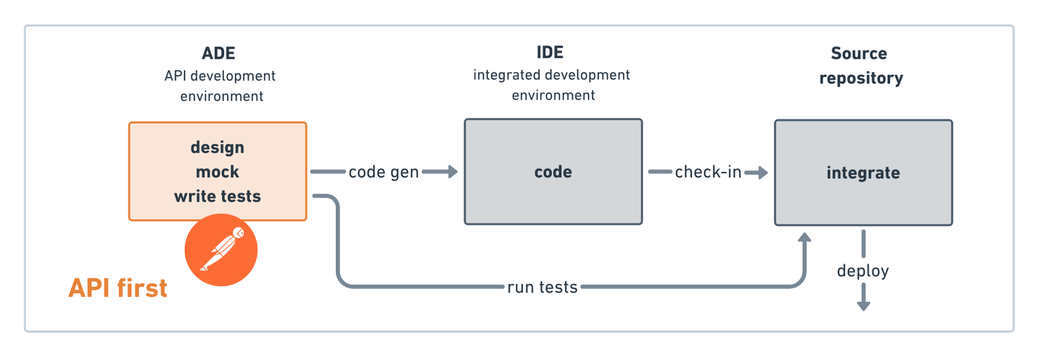
API First Design
There used to be two approaches to application development:
Data First: Define your datamodel and then implement functions/APIs.
UX First: Define and mockup the UI. Test with users. Implement functions.
Cloud Native Microservices often follow API First.
Define APIs.
Implement mockups, simple tests, etc.
Get feedback from potential users and partners.
Deploy and document,
(https://medium.com/adobetech/three-principles-of-api-first-design-fa6666d9f694)
(https://medium.com/better-practices/api-first-software-development-for-modern-organizations-fdbfba9a66d3)

Slide 21
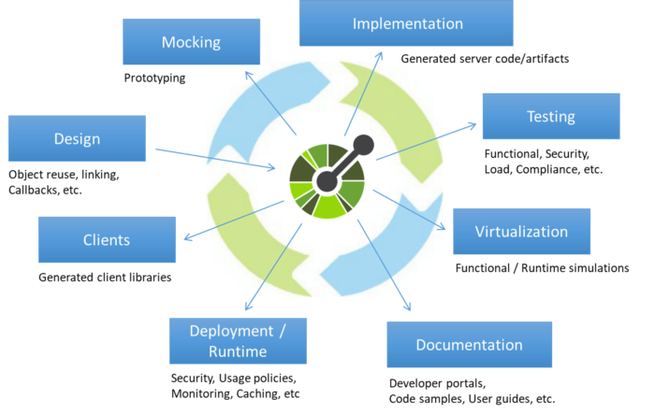
Open API
“The OpenAPI Initiative (OAI) was created by a consortium of forward-looking industry experts who recognize the immense value of standardizing on how APIs are described. As an open governance structure under the Linux Foundation, the OAI is focused on creating, evolving and promoting a vendor neutral description format.” (https://www.openapis.org/about)
There is an interactive “map” that explains the API concepts (http://openapi-map.apihandyman.io/)
I (sometimes) use:
SwaggerHub
Swagger Code Generation
To produce implementation templates from specifications.
Demo the project. (https://github.com/donald-f-ferguson/f21-demo-swagger)
Show SwaggerHub.

Slide 22
Introduction to REST
22 | E6156 – Topics in SW Engineering: Cloud Computing: Lecture 2 – REST, PaaS, S3 © Donald F. Ferguson, 2021

Slide 23
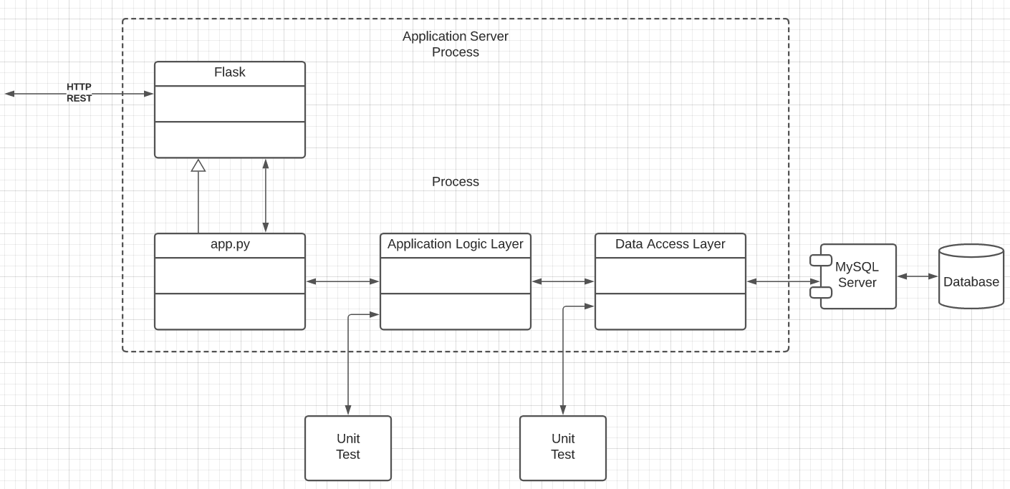
Specification
Build two microservices:
users, addresses
Deploy users on AWS Elastic Beanstalk; deploy addresses on EC2.
Use two separate RDS instances.
Implement a layered architecture:
Data objects for access DBs.
Application logic in app services.
Routing in app.py
Implement paths:
/users
/users/{id}
/users/{id}address
/addresses
/addresses/{addressId}
/addresses/{addressId}/users
Do a very simple UI and deploy on S3.

Slide 24
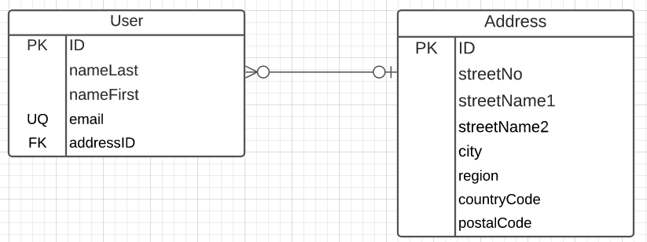
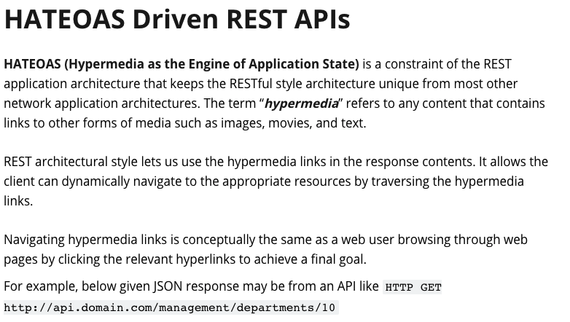
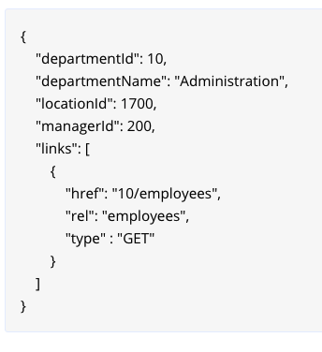
Implement Linked Data
A user has 0 or 1 addresses.
Several people make have the same address.
IDs must be unique and service generated.
Country code must come from a valid list of country codes.
City cannot contain numbers.
Email must have valid format:
Contain “@”
End in one of:
.edu
.com
.org
.mil
Only the following may be NULL
nameFirst
streetName2
https://restfulapi.net/hateoas/

